Slide 1
Logistic Regression
Dr. Uzay Çetin

Slide 2
Data (Ex: Titanic)

Slide 3
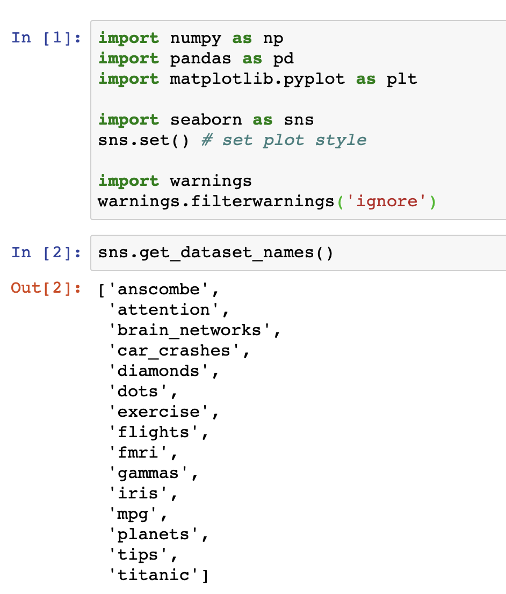
Python Libraries

Slide 4
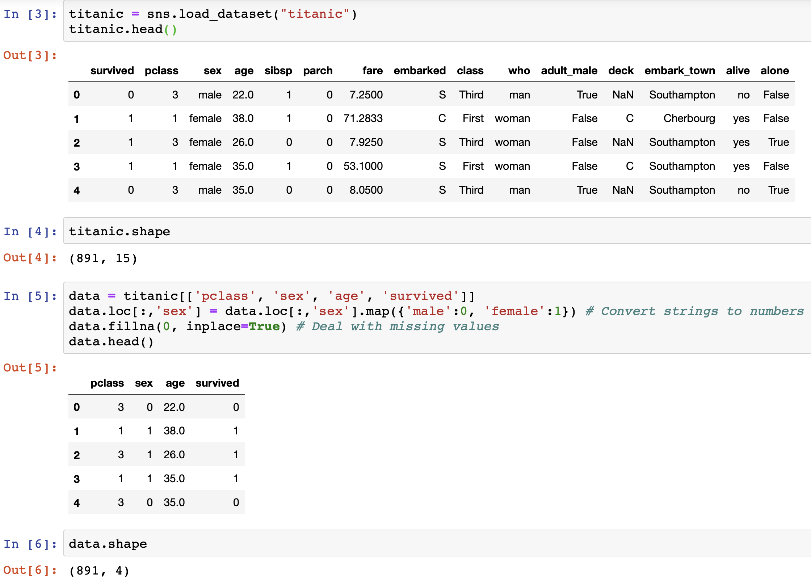
How many observations?
(n =891)
How many features?
(d = 3)

Slide 5
Data

Slide 6
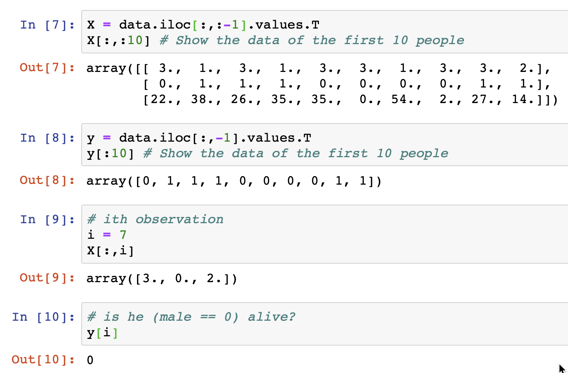
Is 7th person alive? (3rd class 2 years old baby boy, couldn’t make it)

Slide 7
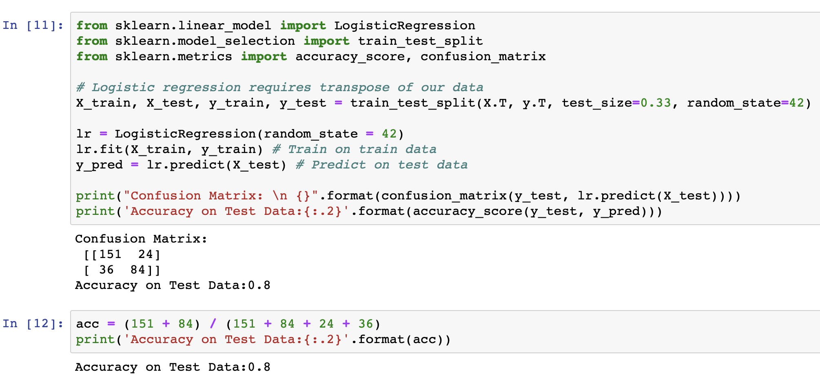
SKLEARN Logistic Regression

Slide 8
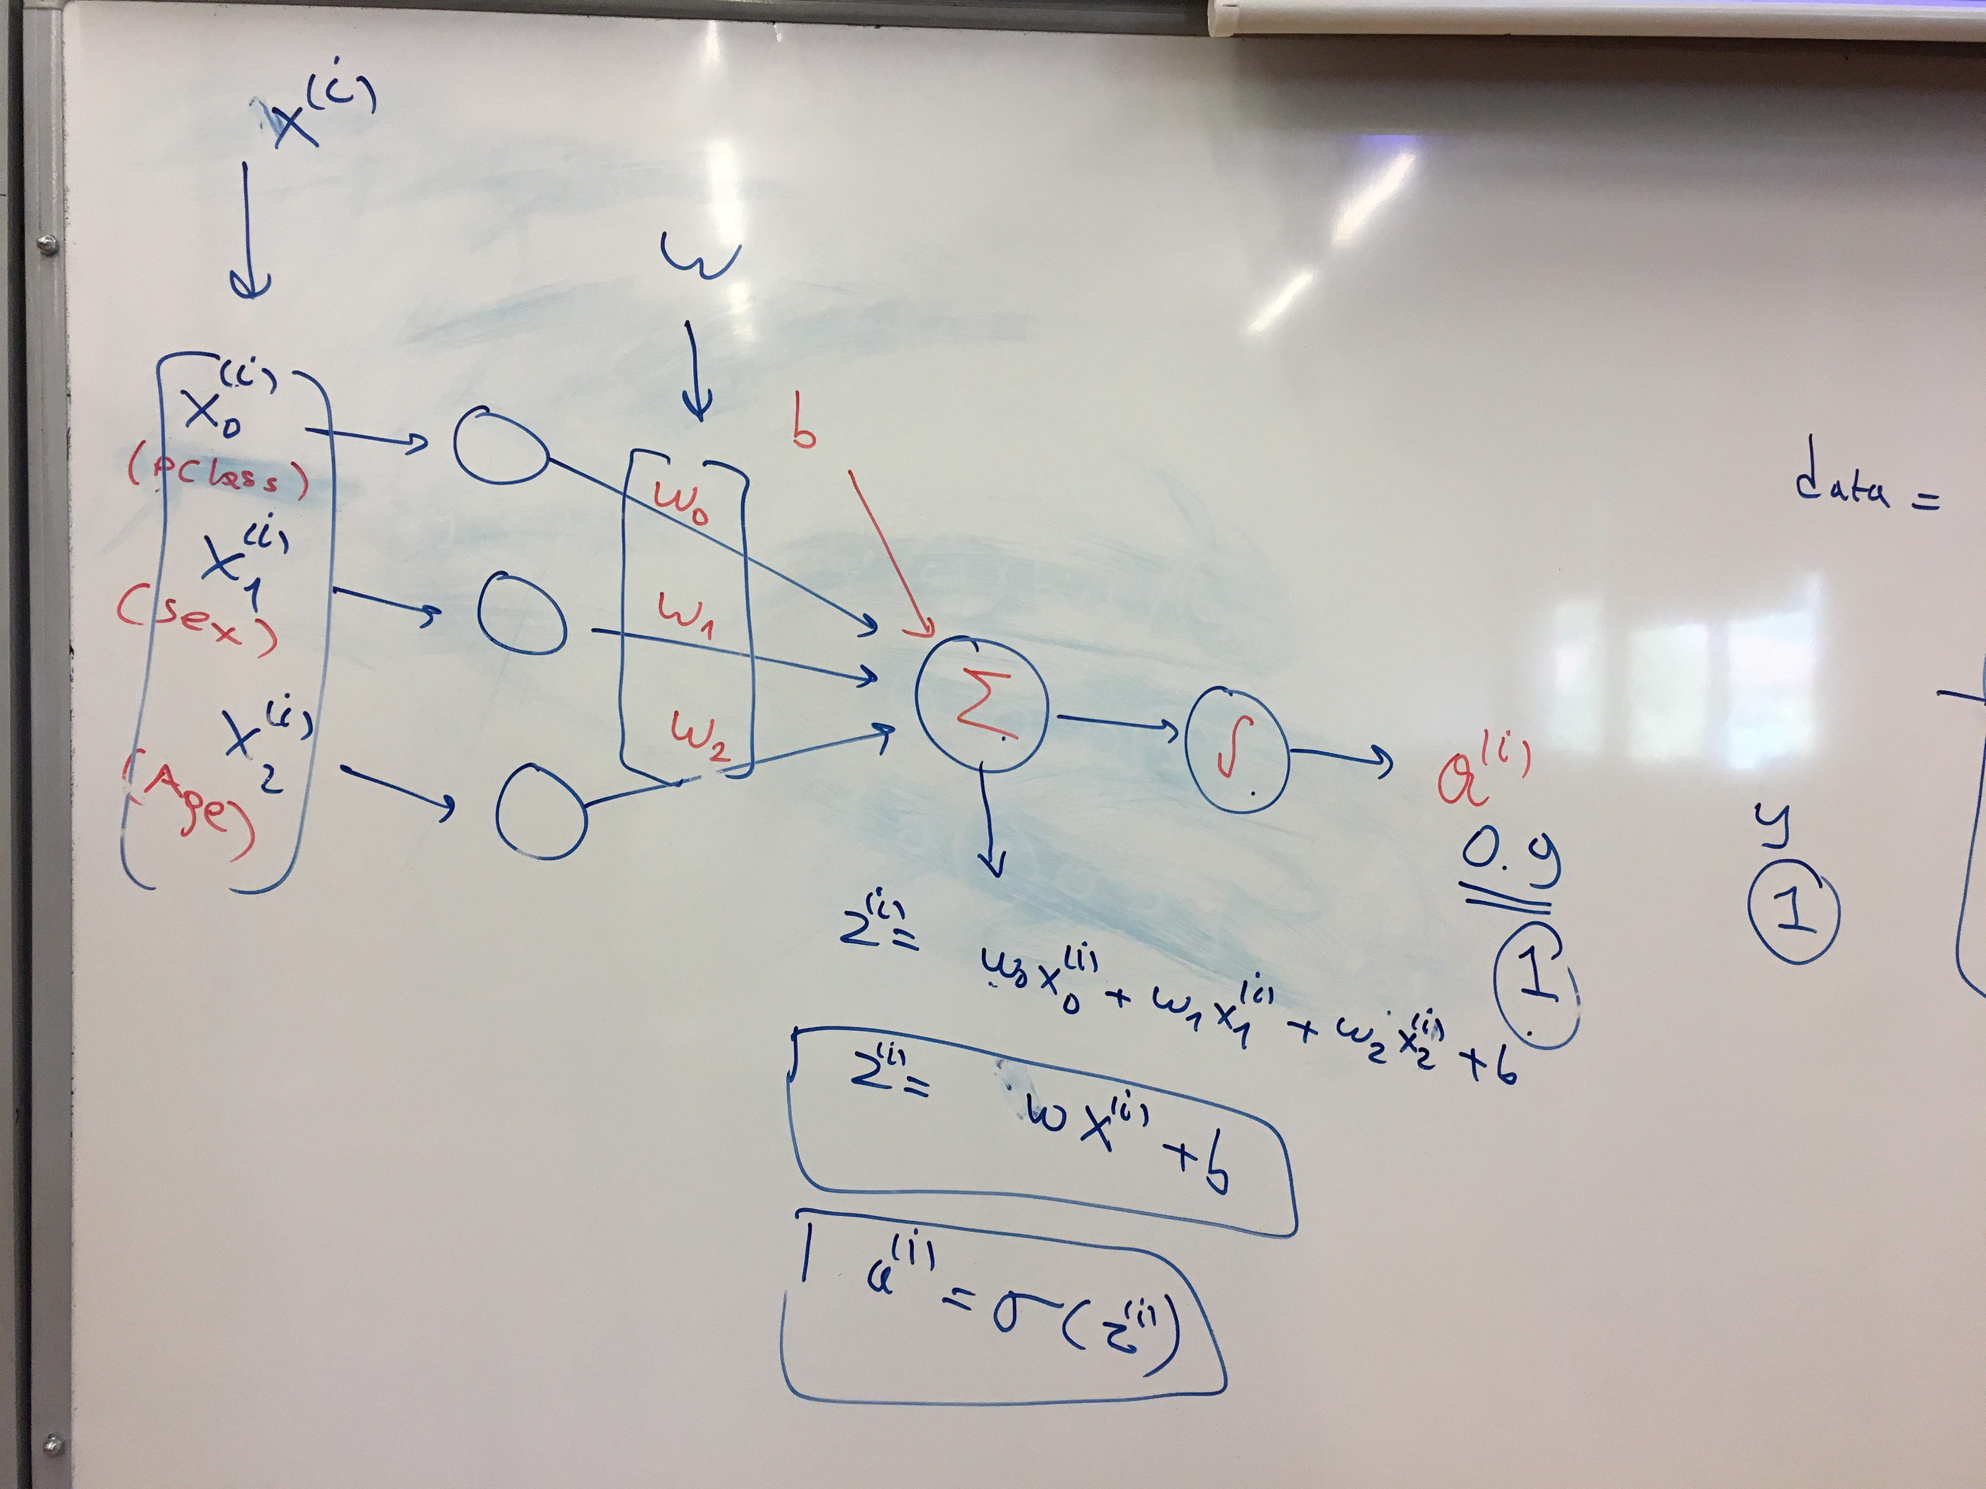
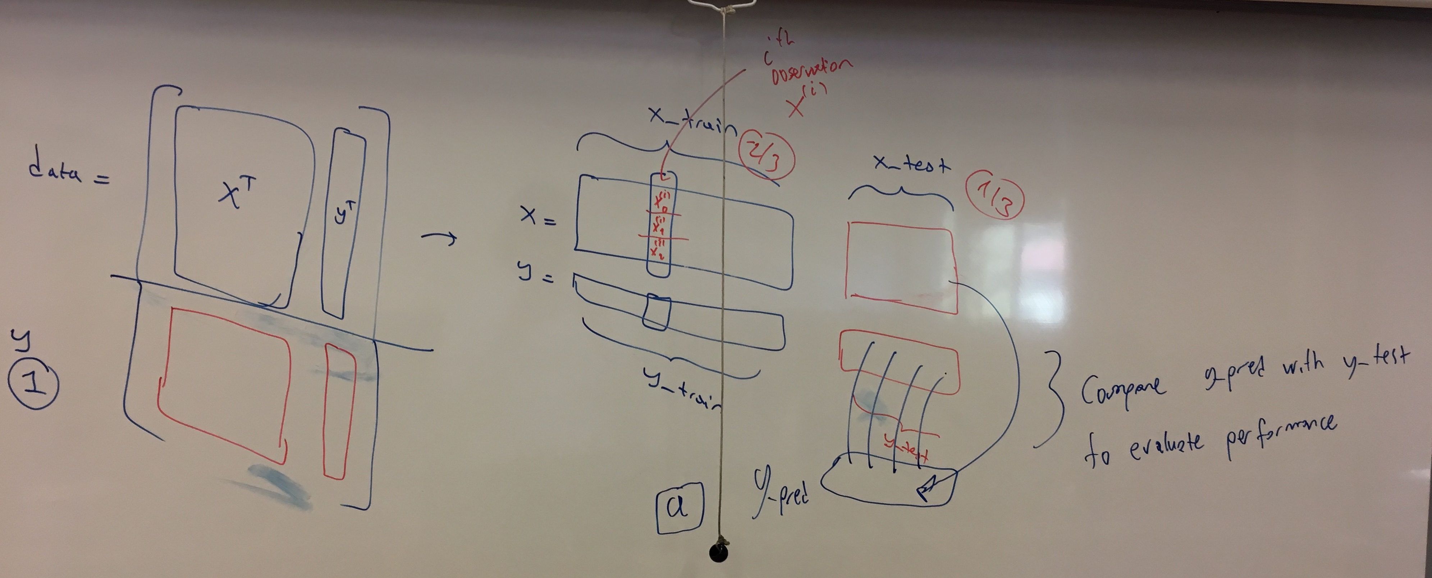

Slide 10
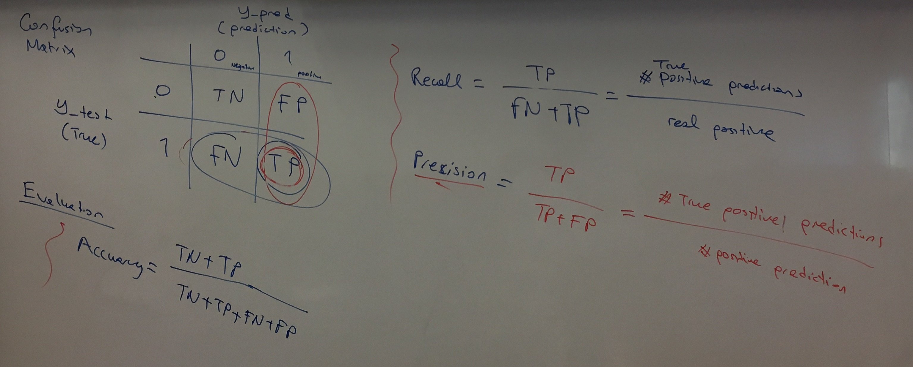
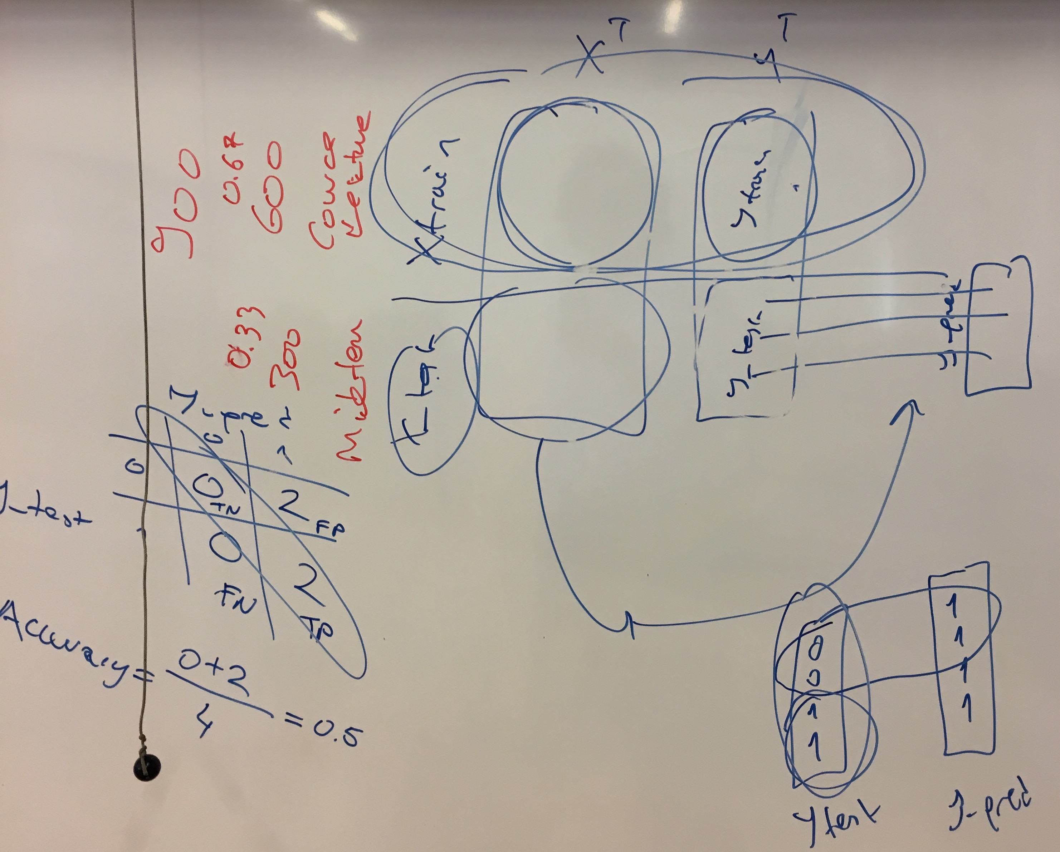

Slide 11
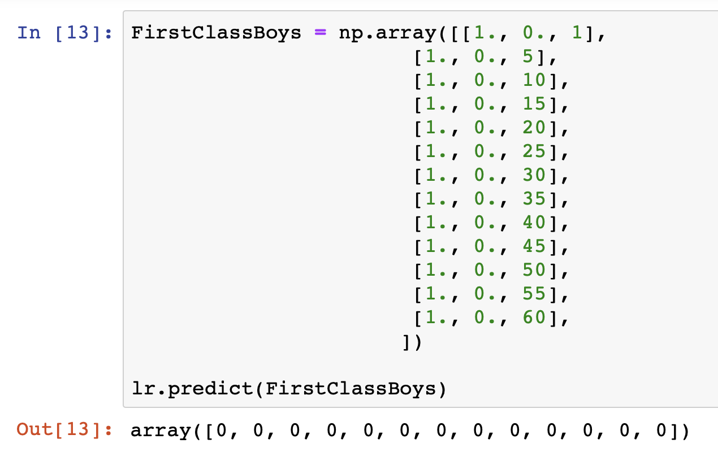
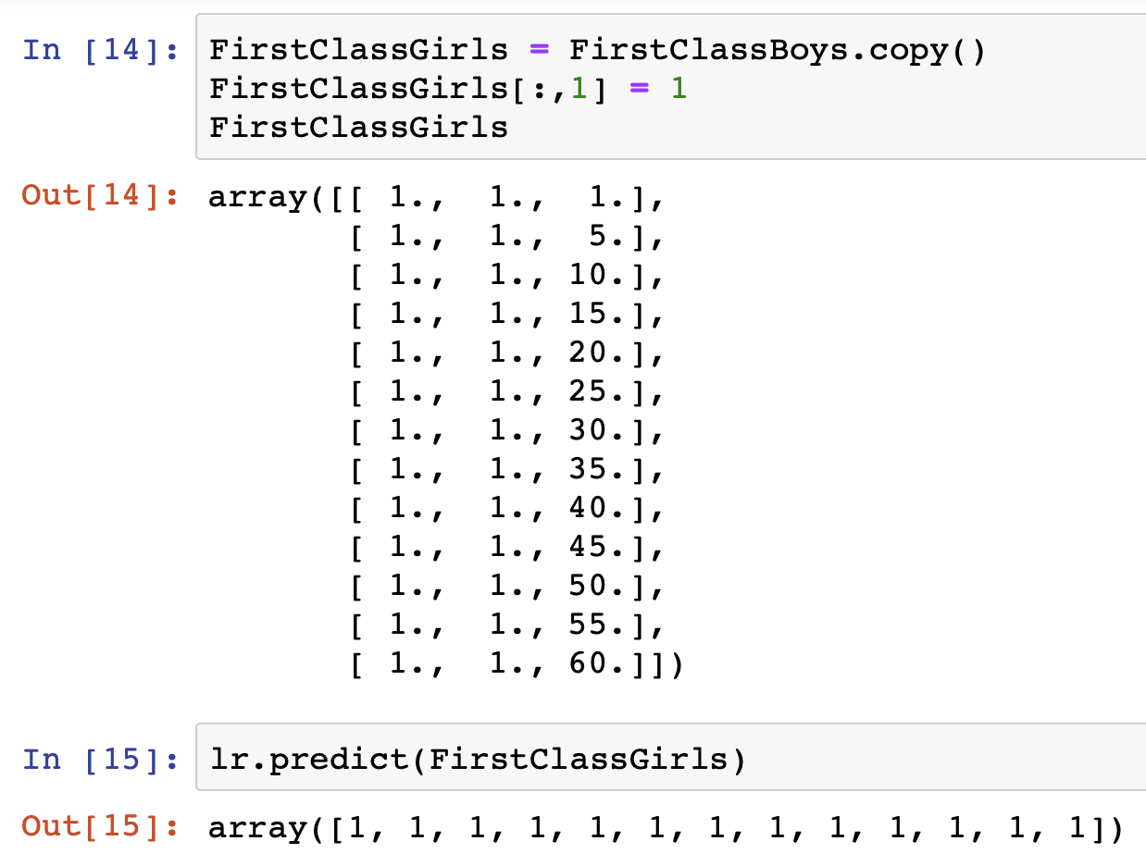

Slide 12
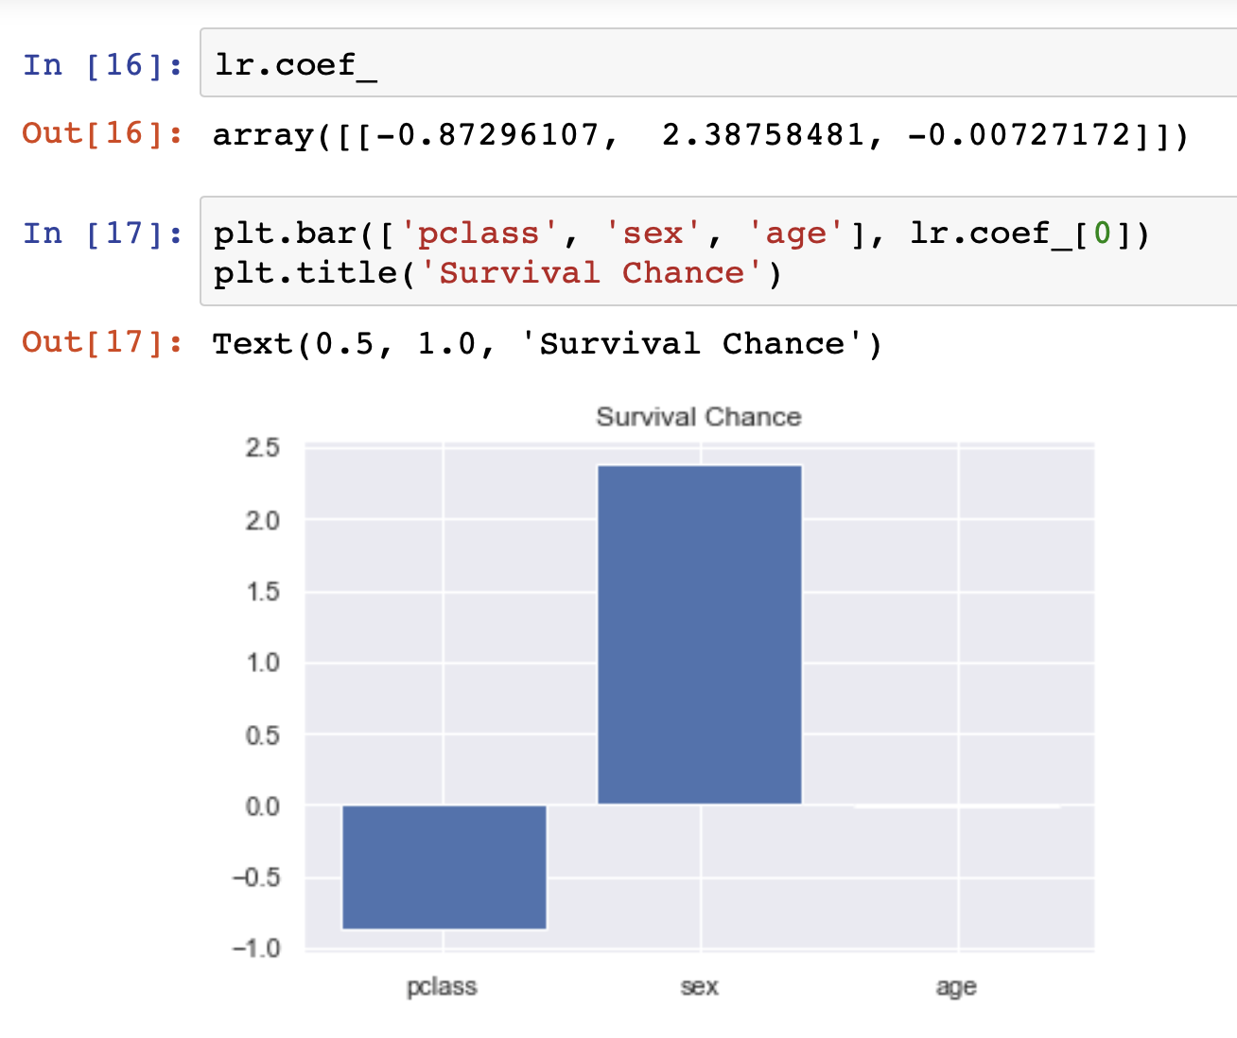

Slide 13
Hand-made Logistic Regression
Model Paramaters w = [w0, …, wd], b
Construct Model a = sigmoid(wX+b)
Compute Loss Function J = Loss(a, y)
Find Derivatives dJ/dw, dJ/db
Apply Gradient Descent Algorithm repeat: w = w – alpha dJ/dw

Slide 14
Model

Slide 15
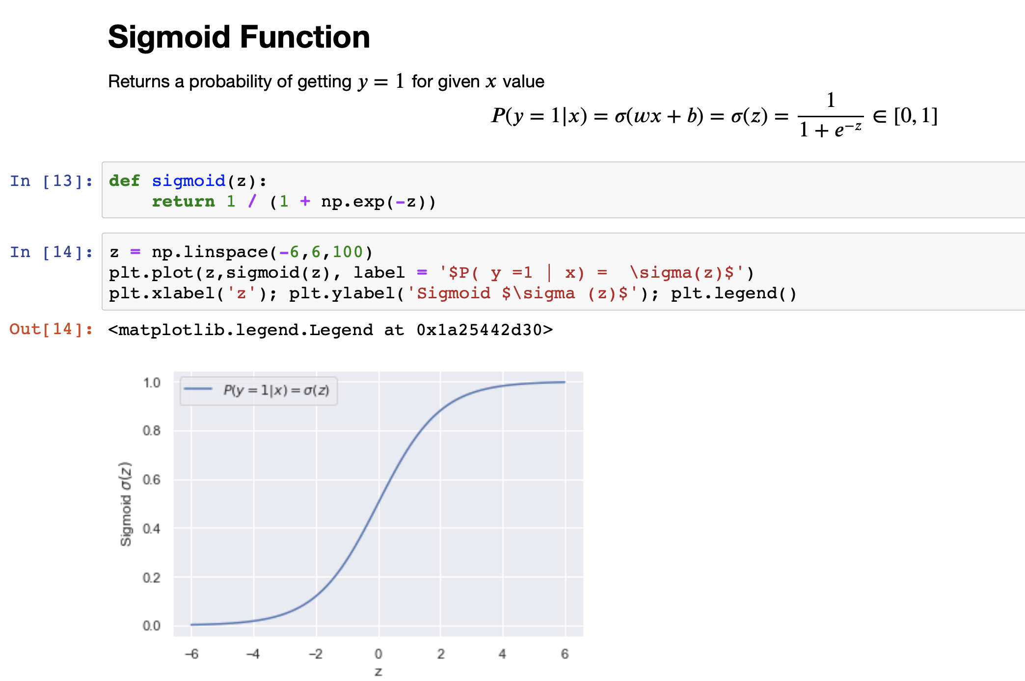

Slide 16
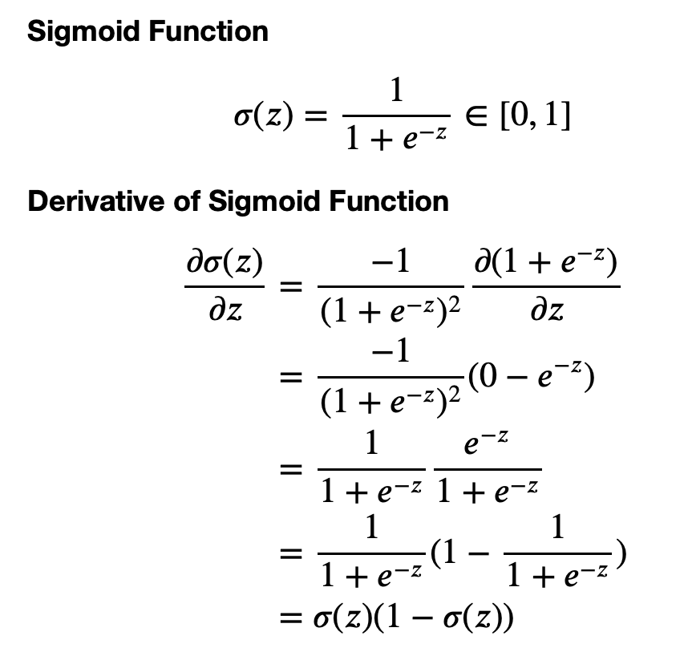
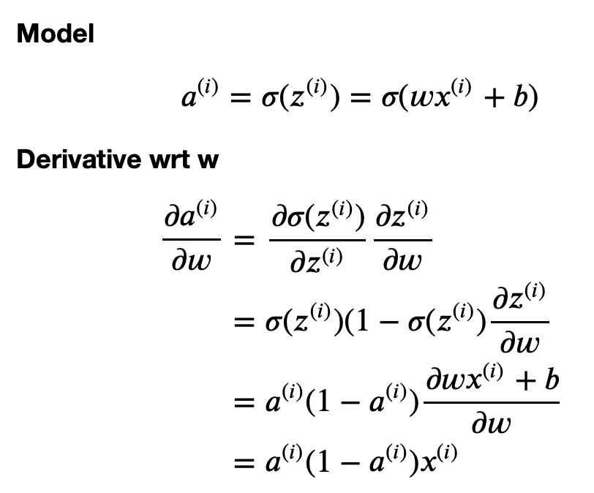
Derivative of Sigmoid Function

Slide 17
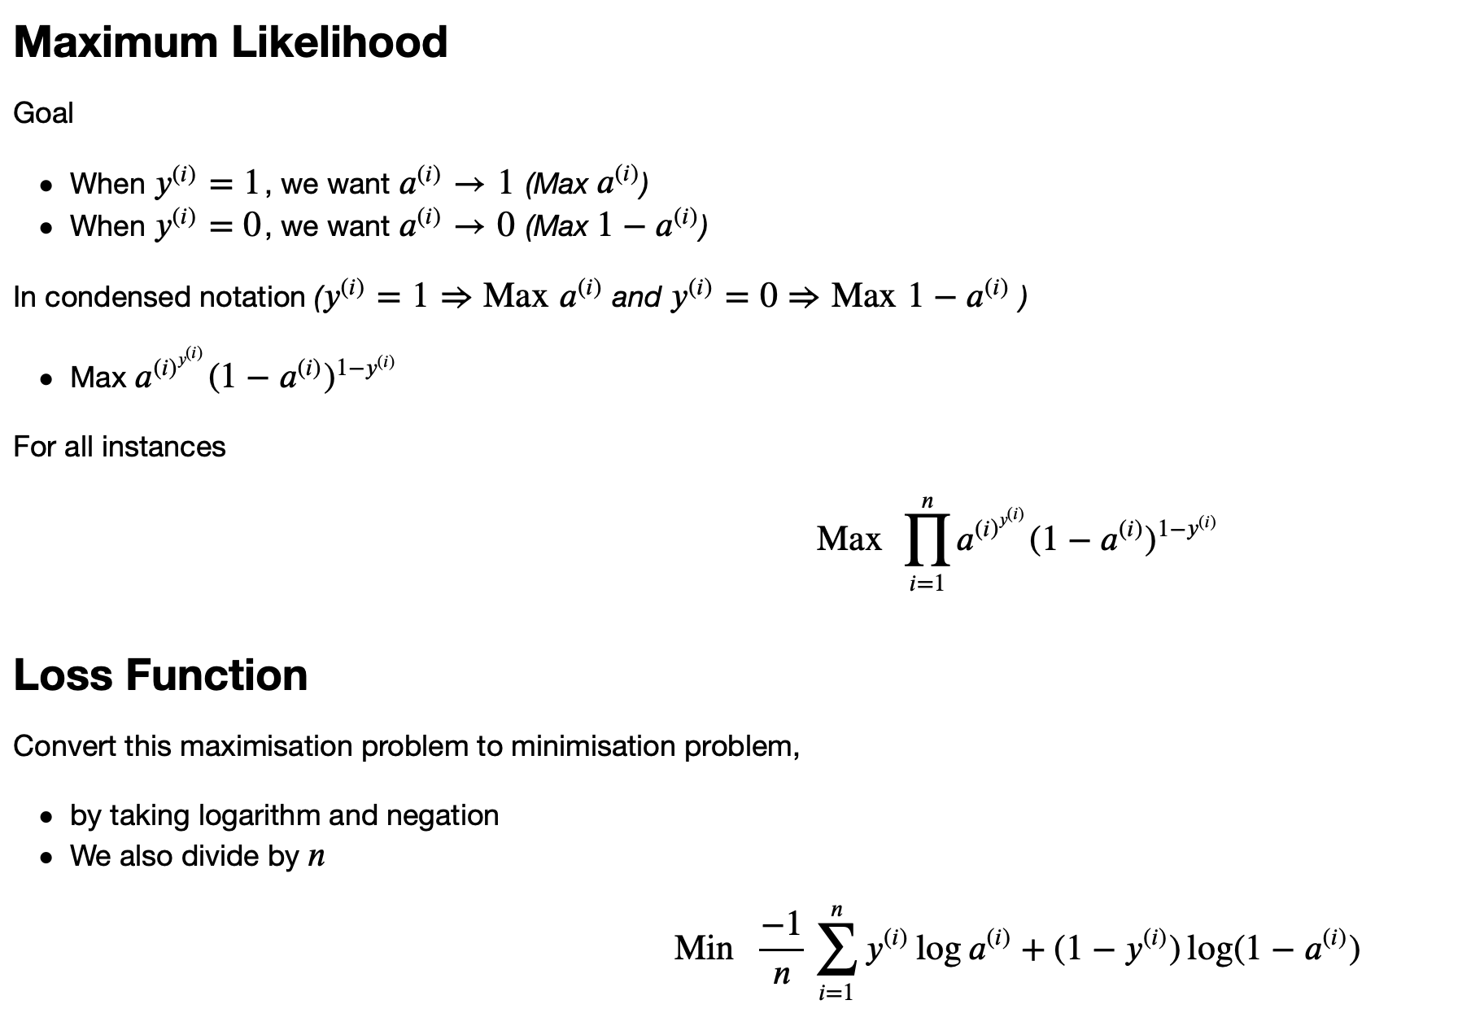

Slide 18
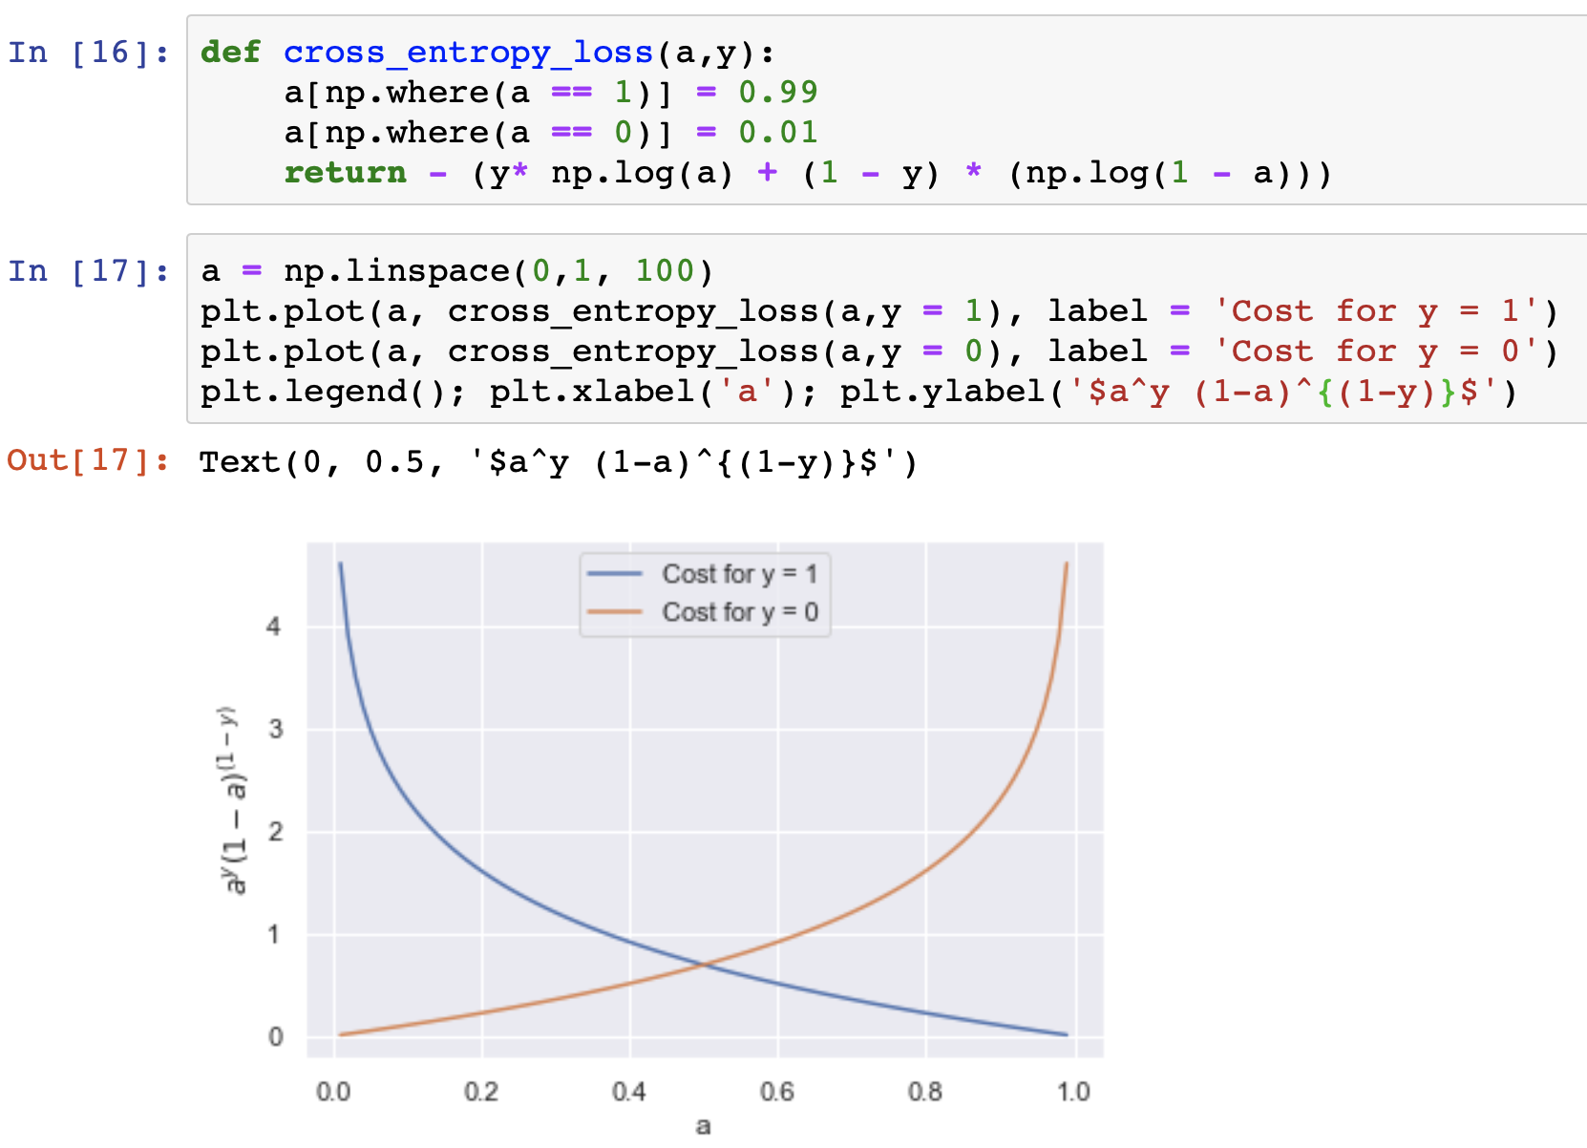
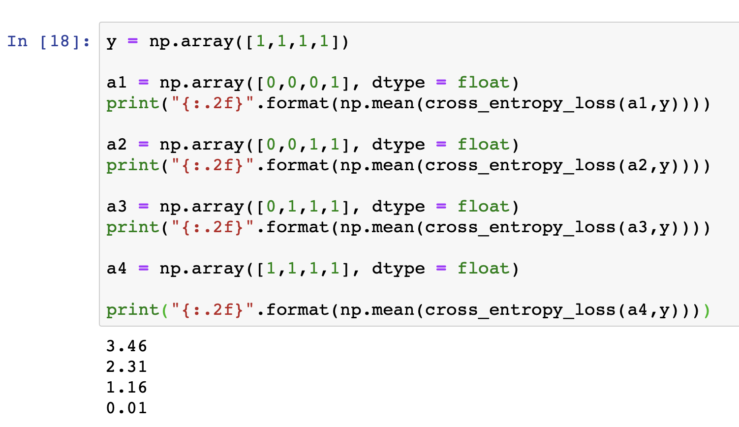
Loss Function

Slide 19
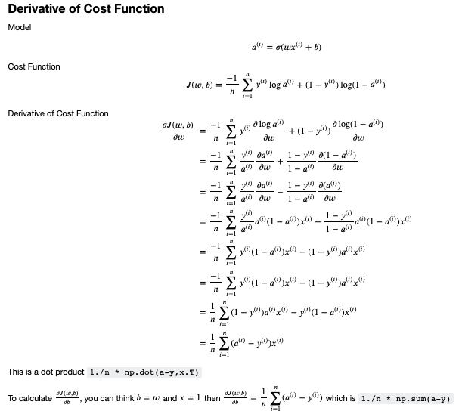

Slide 20
Logistic Regression Code

Slide 21
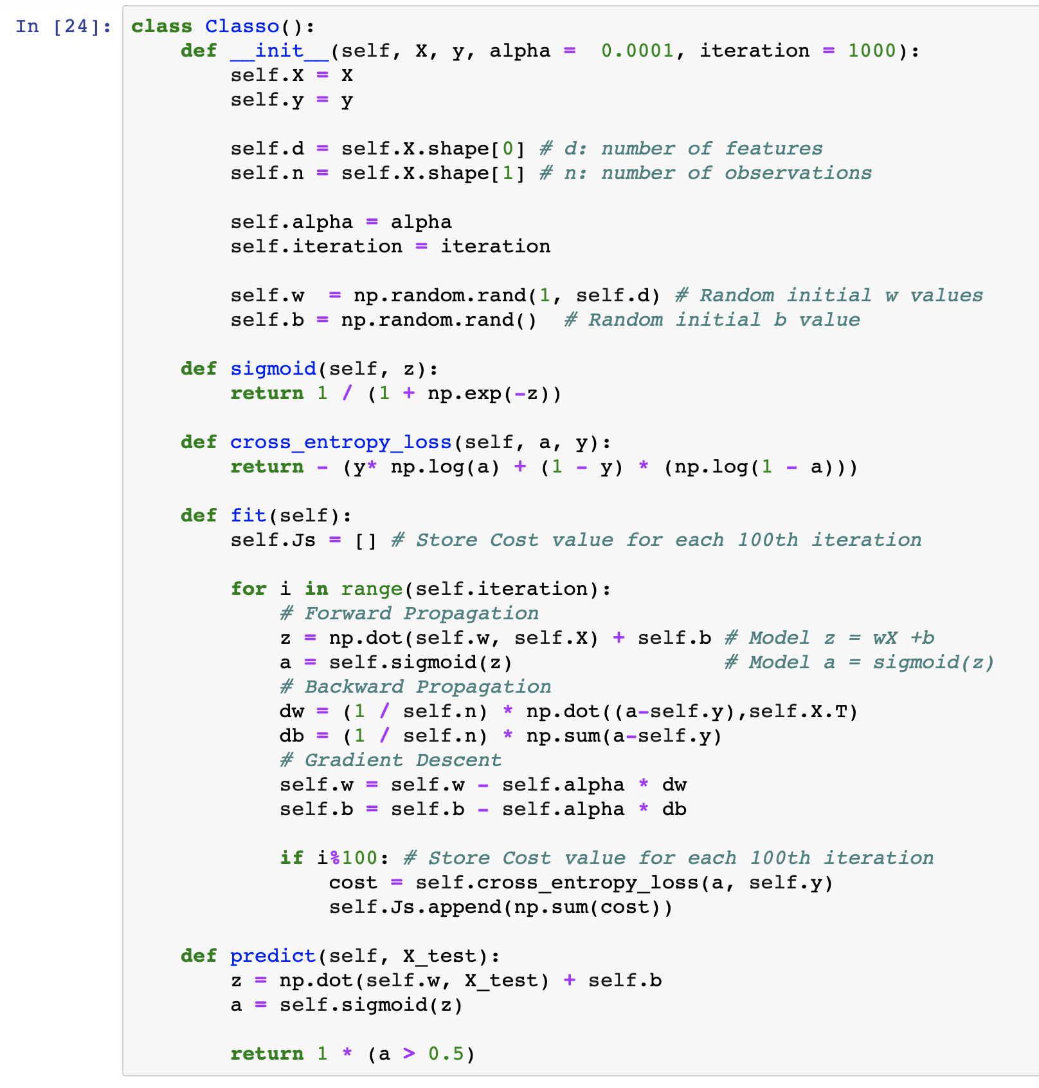

Slide 22
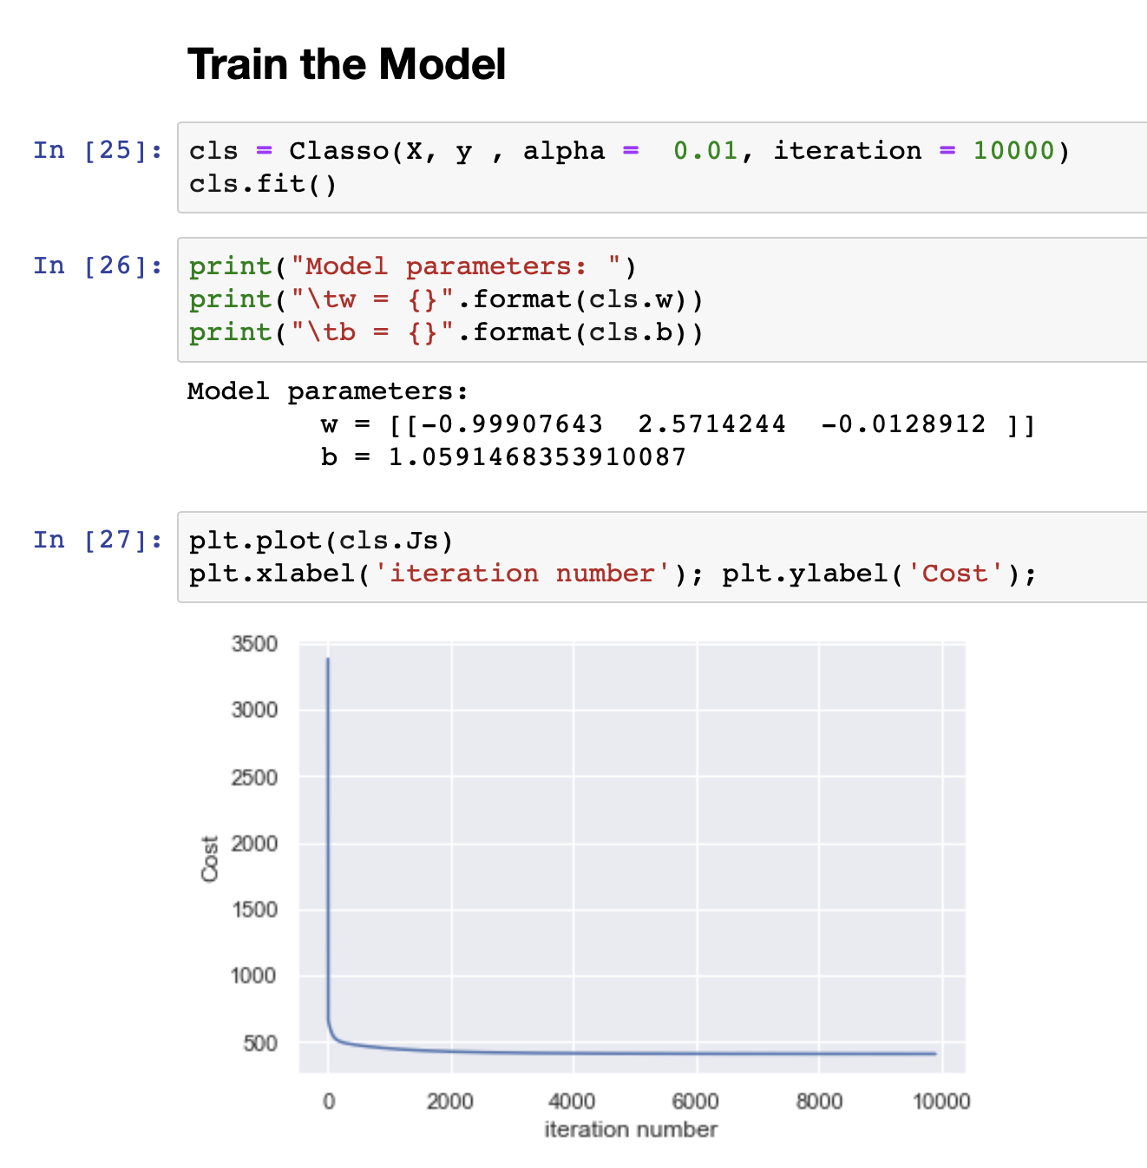
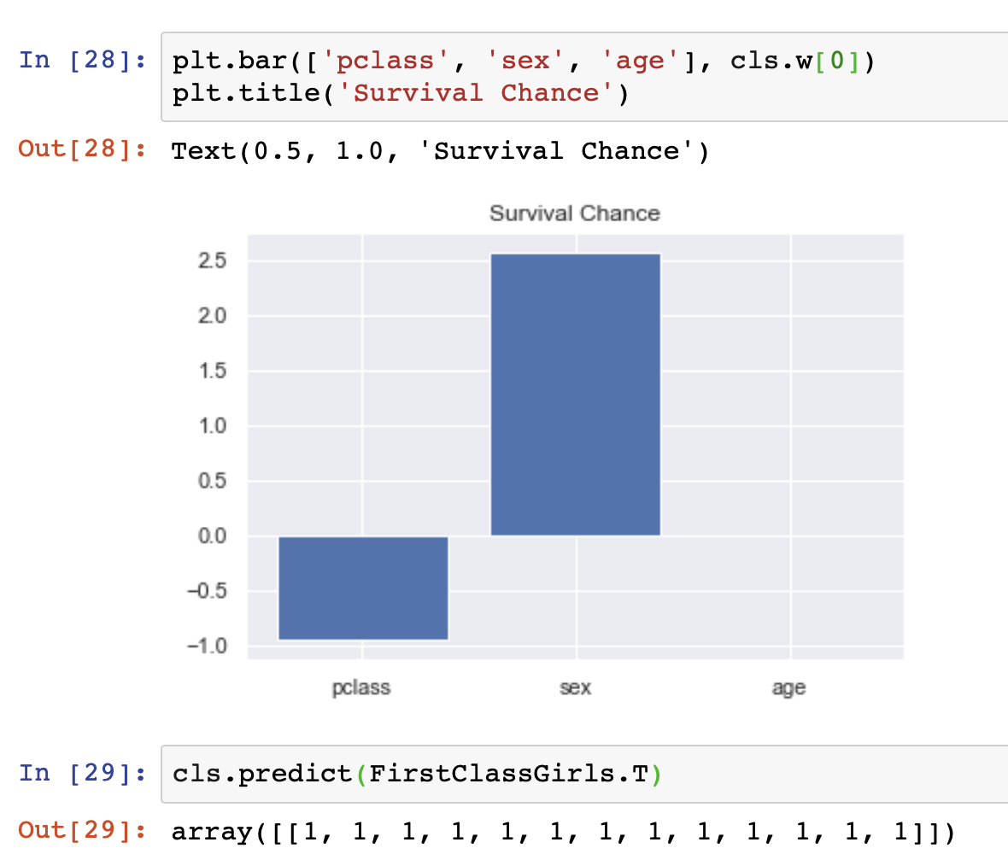

Slide 23
May The Data Be With You :)
uzay00@gmail.com
http://bit.ly/uzaycetin

